Slide 1


Popularity of Things
521479S Software project

Slide 2
Participants
Students
Toni Perälä
Juan Vazquez Moreno
Marius Diamant
Sami-Peeter Laitinen
Customer
Rauli Kaksonen : rauli.kaksonen@oulu.fi
: tperala21@student.oulu.fi
: jvazquez21@student.oulu.fi
: marius.diamant@etudiant.univ-rennes1.fr
: sami-peeter.laitinen@student.oulu.fi

Slide 3
Tasks
Toni : SCRUM master, Twitter API tool, YAML-db
Marius : Reddit API tool, AWS
Sami : Pytrends API for Google search, web scraping
Juan : Docker, web app, AWS

Slide 4
Popularity of Things
PoT: A tool to measure a popularity of a "thing".
Utilizes Google search, social media API and web scraping tools to search indicators of the popularity of a thing
Results from different sources are aggregated and normalized and cached for future use.
Run from Docker container

Slide 5

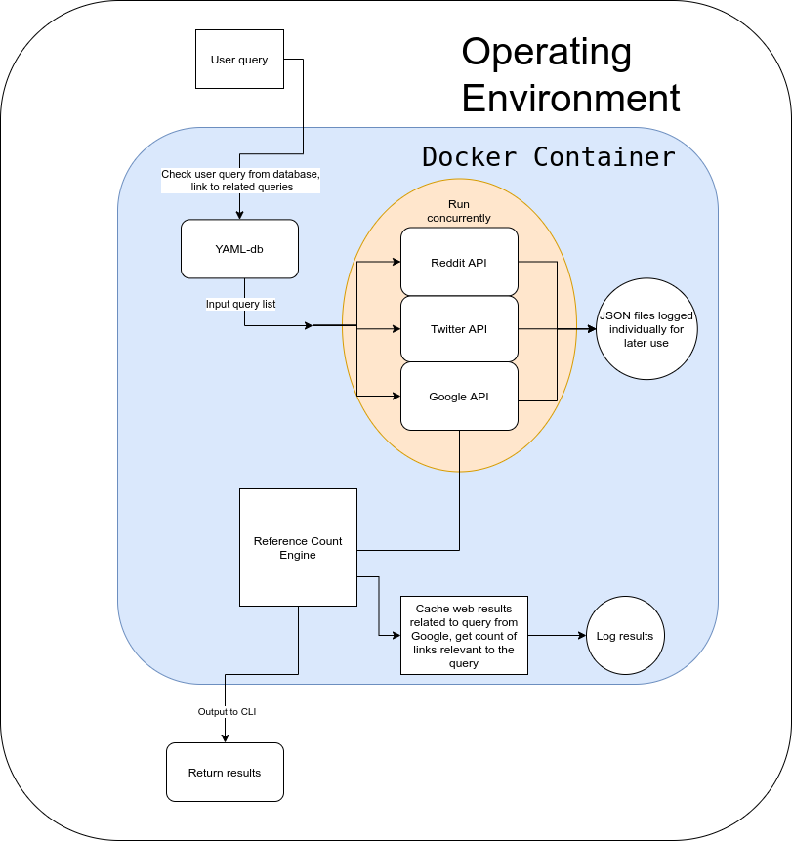




Slide 6
Tools we use
Hardware
AWS EC2 instance running Amazon Linux
Software
Python 3 : Development language
Twitter API, Reddit API, Pytrends, Docker, YAML, Atlassian Jira Board, Github, pip

Slide 7
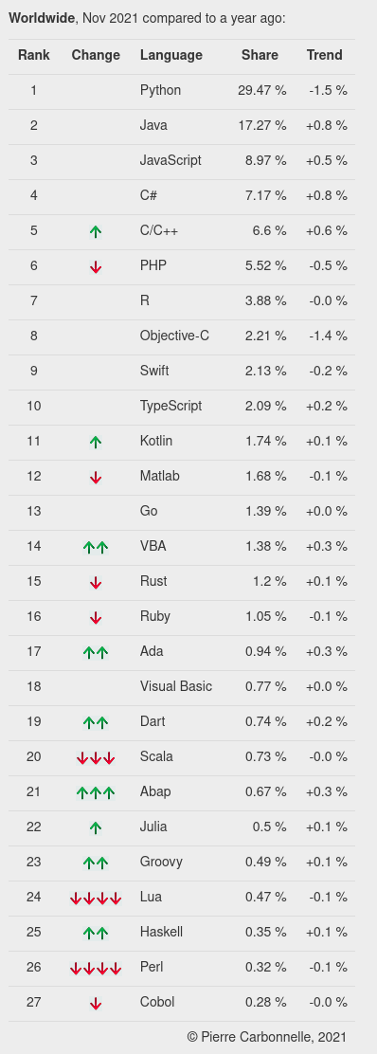
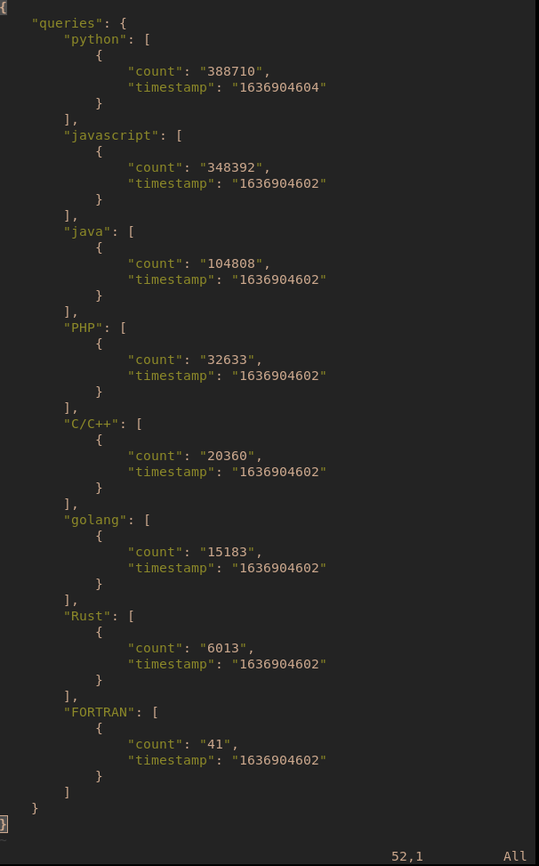

Slide 8
Progress
Initial API test done, JSON output tests completed for Reddit, Twitter and Google.
Docker image tested, updated as changes pushed to repository
Next step: YAML-db dictates output for API queries. Iterate through category of things related to search query, put out normalized list of results, aggregate results

Slide 9
Milestones (so far)
3 Sep. 2021
Group formed
4 Sep. 2021
Client contacted and project selected
10 Sep. 2021
First meeting with client, project tools initialized (Docker, Github, AWS)
15 Sep. 2021
Began research phase
30 Sep. 2021
Tools chosen, testing begins (tested different tools, investigated different API, chose Reddit, Twitter and Google to start with)
15 Oct. 2021
Began development phase
22 Oct. 2021
JSON lists for popularity from different API
13 Nov. 2021
YAML database construction 1st phase

Slide 10
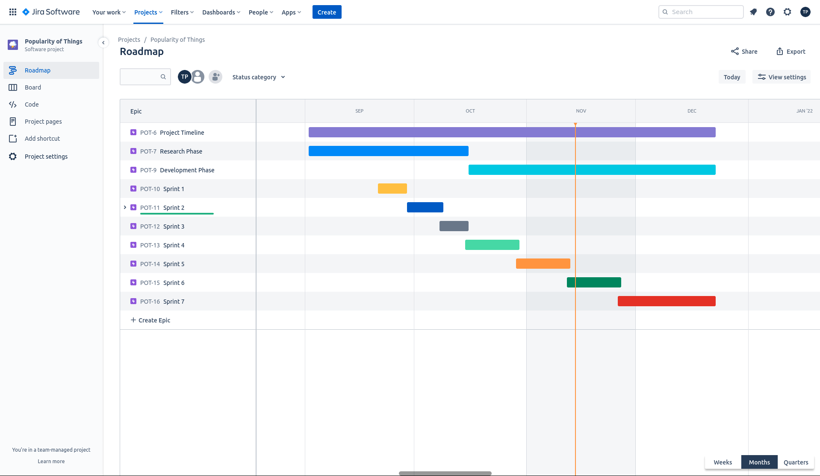
Milestones

Slide 11
Risks / Challenges
Input filtering with different API. Potential fix: Avoid searching for individual letters. (C/C++/C# considered to be the same thing by all API)
API limitations constrict usage. (Pytrends query time limit)
API access is revoked(?!)
Mysterious AWS charges despite instance being down
Bots can skew popularity . Mass posting of a thing alters output. Potential fix is to weigh posts based on likes/retweets etc.
Stories are delayed, deadline pushed back. (unlikely)

Slide 12
What's next?
YAML-database implementation. Feed queries to API tools.
Normalize results into a single list per category
Implement web app for the tool. Currently a simple CLI program.
If extra time, implement additional API and search engines (eg. Stack Overflow, Instagram, Facebook, DuckDuckGo, Bing, Yahoo search etc.)

Slide 13
Q&A
Questions?

Slide 14

Thank you!

